Slide 1
Deadlock Avoidance
The system dynamically considers every request and decides whether it is safe to grant it at this point.
Deadlock avoidance use some advance knowledge of the resource usage of processes.
Following steps are for deadlock avoidance:
When a process request for resource, even if the resource is available for allocation. It is not immediately allocated to that process.
Advance knowledge used to perform analysis to decide whether process’s request is safe or unsafe.
When request is safe, resource allocated, otherwise deferred.
‹#›

Slide 2
Deadlock Avoidance cont..
Safe State:
A system is considered in safe state , if there exists some ordering of processes in which run all requests lead to completion .
Safe Ordering (sequence):
Any ordering of processes, that can guarantee the completion of all the process is called safe sequence.
‹#›

Slide 3
Deadlock Avoidance cont..
In a system there are 8 units of particular resource type.
Three processes P1,P2 and P3 are competing.
Explanation in next diagram.
‹#›

Slide 4
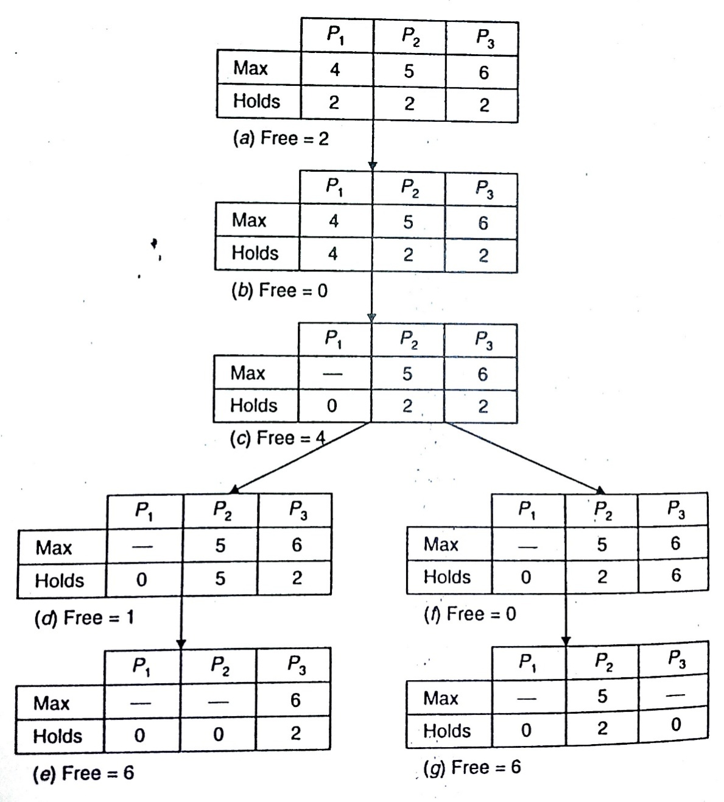
Deadlock Avoidance cont..
‹#›

Slide 5
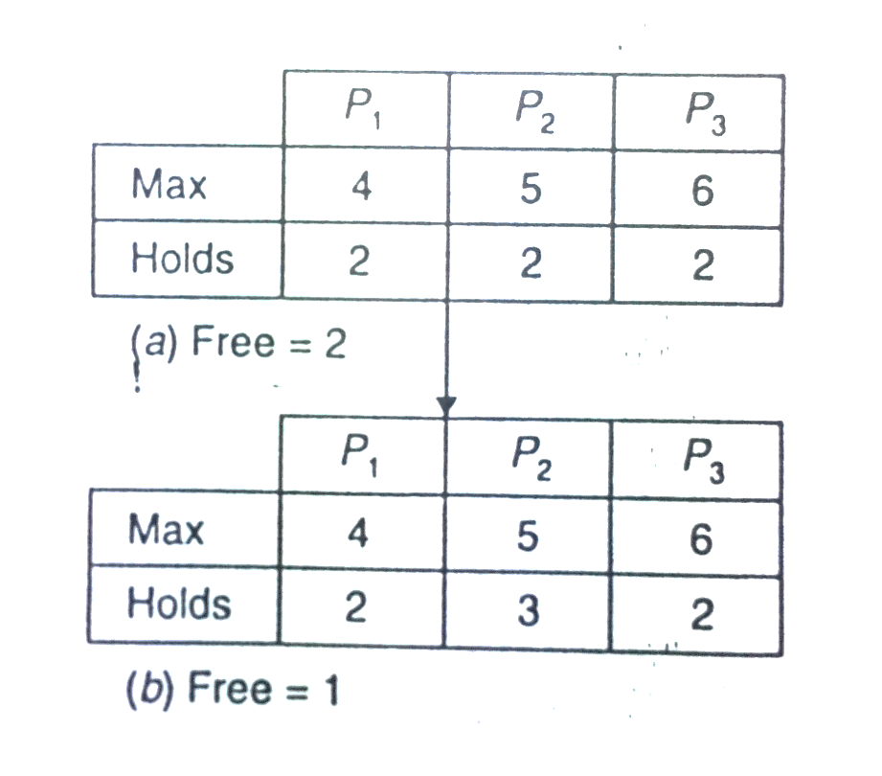
Deadlock Avoidance cont..
If resource allocation is not done carefully , the system move from a safe sate to unsafe state.
‹#›

Slide 6
Deadlock Avoidance cont..
It is important to note the following remarks about safe and unsafe states:
The initial state in which no resources are yet allocated is called safe state.
Safe state, the system can guarantee that all processes can be run to completion.
An unsafe state is not a deadlock state, but it may lead to a deadlock state, the system cannot guarantee that all processes can be run to completion.
‹#›

Slide 7
Deadlock Avoidance cont..
It is important to note the following remarks about safe and unsafe states:
The initial state in which no resources are yet allocated is called safe state.
Safe state, the system can guarantee that all processes can be run to completion.
An unsafe state is not a deadlock state, but it may lead to a deadlock state, the system cannot guarantee that all processes can be run to completion.
‹#›

Slide 8
Deadlock Avoidance cont..
Due to following reason , avoidance rarely used:
Assumption of advance knowledge is available, however in practice, processes rarely know in advance what their maximum resource needs will be.
Number of processes not known in advance, because dynamically varies. ( user login , logout)
Number of units change dynamically (machine crash).
Restriction on resource allocation , degrades the system performance.
‹#›

Slide 9
Deadlock Detection
Uses algorithm that keeps examing state of system to determine whether a deadlock has occurred.
When deadlock has occurred system takes action to recover.
Algorithms are same for centralized as well as distributed.
Uses resource allocation graph and searching for cycle or not depending upon single or multiple units of resources.
Following steps are needed to construct Weight For Graph(WFG).
Construct separate Resource allocation graph for each site. Resource node exists for all local resources and process node exists for all processes that are either holding or waiting for resource.
Construct WFG by removing resources and collapsing edges.
Take union of all WFG of all sites and construct single global WFG.

Slide 10
Deadlock Detection Cont…
Two sites, site 1 with 2 resources and site 2 with 1 resource.
P1 is holding R1 and requesting for R3.
P2 is holding R2 and requesting for R1.
P3 is holding R3 and requesting for R2
Union of WFG of two sites will show either deadlock exists or not.
Local WFG does not contain cycle while Global has.
Difficulties: Maintaining WFG of each site is difficult.
Most important feature of deadlock detection algorithm is correctness which depends on these properties.
1) Progress Property:
Deadlocks must be detected in finite amount of time.
2) Safety Property:
Detected deadlock must exist. Message delays and out of date WFG cause false cycles to be detected. It results in detection of deadlocks that do not exist called phantom deadlocks.

Slide 11
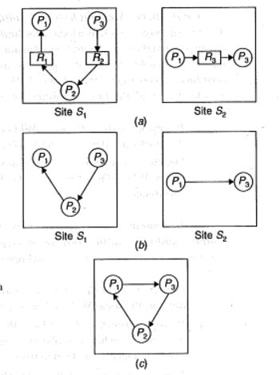
Diagram

Slide 12
Deadlock Detection Cont..
Three commonly used techniques for organizing WFG in a distributes system are..
Centralized Algorithms.
Distributed Algorithms
Hierarchical Algorithms.

Slide 13
Centralized Approach
Local coordinator at each site that maintains WFG of its local resources.
Central coordinator that is responsible for constructing union of all WFG.
Central coordinator constructs global WFG from information received form local coordinator of all sites.
Deadlock detection is performed as follows.
If cycle exists in local WFG of any site, it represents local deadlock. Such deadlocks are detected and resolved by local coordinator.
Deadlocks involving resources at two or more sites get reflected as cycles in global WFG. Such deadlocks are detected and handled by central coordinator.

Slide 14
Centralized Approach Cont..
In centralized approach messages are sent form local to central coordinator to transfer information as follows.
Continuous Transfer: local coordinator send message whenever an new edge is added or deleted
Periodic Transfer: local coordinator sends message after fix time when no changes have occurred.(in order to reduce messages)
Transfer on Request: on request of central coordinator. Central coordinator invokes cycle detection algorithm periodically and requests information from each site just before invoking algo.
Drawbacks:
Failure of central coordinator. Back up can resolve issue.
Central coordinator will become performance bottle neck in large system having to many sites.
It may detect false deadlocks or phantom.

Slide 15
Centralized Approach Cont..
3 processes(p1,p2,p3) compete for 3 resources(R1,R2,R3)
Step 1: p1 requests for R1 and R1 is allocated to it.
Step 2: p2 requests for R2 and R2 is allocated to it.
Step 3: p3 requests for R3 and R3 is allocated to it.
Step 4: p2 requests for R1 and waits for it.
Step 5: p1 requests for R2 and waits for it.
Step 6: P1 releases R1 and R1 is allocated to P2.
Step 7: p1 requests for R3 and waits for it.

Slide 16
Centralized Approach Cont..
m1: from site S1 to add edge (R1,P1)
m2: from site S1 to add edge (R2,P2)
m3: from site S2 to add edge (R3,P3)
m4: from site S1 to add edge (P2,R1)
m5: from site S1 to add edge (P3,R2)
m6: from site S1 to delete edges (R1,P1) and (P2,R1) and edge (R1,P2)
m7: from site S2 to add edge (P1,R3)
If all these messages are in order than no problem.
If message 7 from site 2 comes earlier than message 6 from site 6 than central coordinator will incorrectly conclude that deadlock has occurred and will start to recover. This example follows continuous transfer, same problem will also be with other two methods.
One method to avoid the detection of false deadlocks is to use Lamport's algorithm to append a unique global example, since message timestamp with each message. In our above m- from site Sz to the central coordinator is caused by the request from site SI (see step 7), message m- will have a later timestamp than message m6' Now if the central coordinator receives message m- before m6 and detects a false deadlock, before taking any action to resolve the deadlock, it first confirms if the detected deadlock is a real one. For confirmation, it broadcasts a message asking all sites if any site has a message with timestamp earlier than T for updation of the global WFG. On receiving this message, if a site has a message with timestamp earlier than T, it immediately sends it to the central coordinator; otherwise it simply sends a negative reply. After receiving replies from all the sites, the central coordinator updates the global WFG (if there are any update messages), and if the cycle detected before still exists, it concludes that the deadlock is a real one an initiates recovery actions. Notice that in our above example, in reply to its broadcast message, the central coordinator will receive message m6 from site S1, and a negative reply from site S2

Slide 17
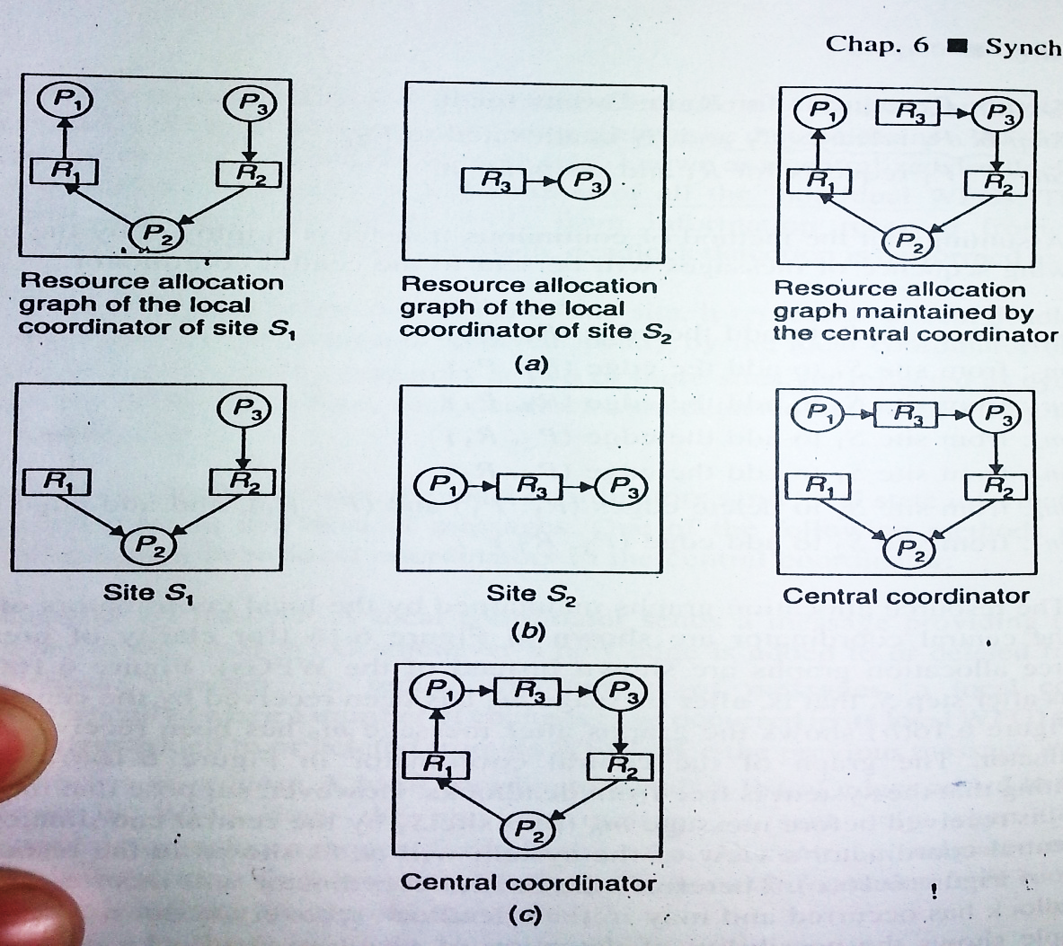
Diagram

Slide 18
Hierarchical Approach
Drawbacks of Centralized Approach:
Most WFG cycles are very short.
90% of all deadlock cycles involve only two processes.
So centralized approach seems less attractive because of time and overhead involved in assembling local WFG at central coordinator.
Deadlock should be detected by a site located as close as possible to sites involved in cycle to minimize communication cost.
Solution:
Hierarchical approach solves this issue.

Slide 19
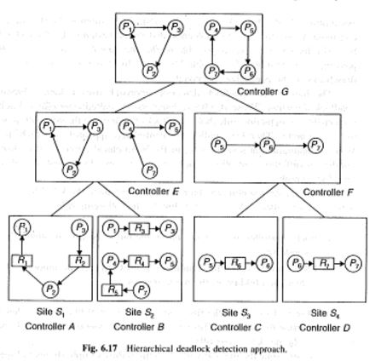
Diagram

Slide 20
Hierarchical Approach Cont…
Uses logical hierarchy(tree) of deadlock detectors.
Deadlock detectors are called controllers.
Each controller is responsible for deadlocks that involves sites falling within its range.
Unlike centralized approach instead of maintaining WFG at a single site, it is distributed over no. of controllers.
WFG is maintained on following rules.
Each controller that forms a tree of hierarchy tree maintains local WFG of single site.
Each non-leaf controller maintains WFG that is union of WFGs of its immediate children in hierarchy tree.

Slide 21
Fully Distributed Approaches for deadlock detection
Each site of system shares equal responsibility for deadlock detection.
Types:
WFG based Distributed algorithm for deadlock detection.
Probe based Distributed algorithm for deadlock detection.

Slide 22
WFG based Distributed algorithm for deadlock detection.
Each site maintains its own WFG.
Extra node Pex is added to local WFG of each site, and this node is connected to WFG of corresponding site in following manner.
1) An edge(Pi, Pex) is added if processes Pi is waiting for resource in another site held by any other process.
2) An edge(Pex,Pj) is added if Pj is a process of another site that is waiting for a resource currently held by process of this site.

Slide 23
WFG based Distributed algorithm for deadlock detection cont...
1) in the WFG of site S1, edge (P1,Pex) is added because process P1 is waiting for a resource in site S2, that is held by process P3, and edge(Pex,P3) IS ADDED BECAUSE process P3 is process of site S2, that is waiting to acquire a resource currently held by process P2 of site S1.
2) in the WFG of site S2, edge (P3,Pex) is added because process P3 is waiting for a resource in site S1, that is held by process P2, and edge(Pex,P1) IS Added Because process P3 is process of site S2, that is waiting to acquire a resource currently held by process P2 of site S1.
Deadlock Handling:
If local WFG contains a cycle that does not involve node Pex, a deadlock that involves only local process of that site has occurred. Such deadlocks are handled locally.
If local WFG contains a cycle that involves node Pex, there is possibility of distributed deadlock that involves process of multiple sites. For confirmation deadlock distribution algorithm is invoked by site whose WFG contains a cycle involving node Pex.

Slide 24
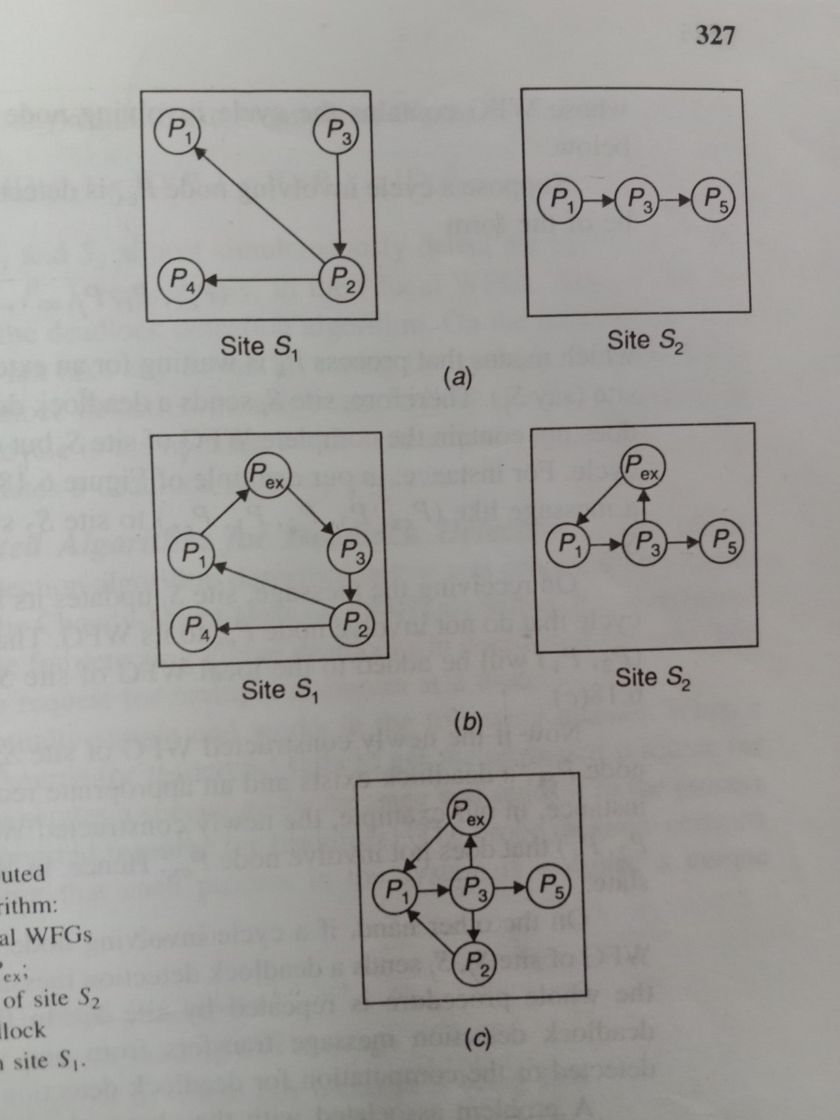
‹#›

Slide 25
Probe based Distributed algorithm for deadlock detection
Best algorithm for detecting global deadlocks in distributed system.
Algorithm allows a process to request multiple resources at a time.
When a process requests for a resource or resources fails to get requested resource and times out, it generates special probe message and sends it to process holding the requested resources.
Probe message contains following fields.
The identifier of process just blocked.
The identifier of process sending message.
The identifier of process to whom the message is being sent.

Slide 26
Probe based Distributed algorithm for deadlock detection cont…
On receiving a probe message, receipt checks to see if it itself is waiting for any resource or resources. If not this means that receipt is using the resource requested by the process that sent probe message to it. Receiver simply ignores probe message..
On the other hand if receipt is waiting for any resource it passes the probe message to the process or processes holding the resource for which it is waiting . However probe message is forwarded.
Receipt modifies its field in following manner.
The first field is left unchanged.
The receipt changes the 2nd field to its own process identifier.
3rd field is changed to identifier of process that will be new receipt of this message.
Every new receipt of probe message repeats this procedure. If probe message returns back to its original sender a cycle exists and system is deadlocked.

Slide 27
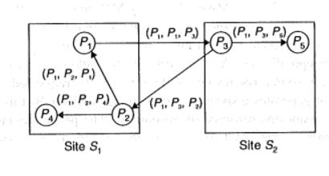
Probe based Distributed algorithm for deadlock detection cont…
Attractive Features:
easy to implement, since message is of fix length and requires few steps for computation.
Low overhead
No need of graph construction
False deadlocks are not detected.
No specific structure required among processes.

Slide 28
Ways for recovery from deadlock
Asking for operator intervention
Termination of process or processes.
Rollback of processes.
Asking for operator intervention: system assist the operator in decision making for recovery by providing him list of processes involved in deadlock. It is handled manually. Console is used to continuously monitor smooth running. Every site has an operator to handle deadlock.
Drawbacks:
Not used in modern systems.
Not suitable for distributed environment because each site operator will take some action for recovery.
If operator of single site is informed. It may favor it’s own processes.
Operator of one site may not have rite to interfere with other

Slide 29
Ways for recovery from deadlock
2) Termination of process or processes:
Simplest way to recover deadlock automatically by killing one or more processes and reclaim the resources held by them
algorithms of this type analyze resource requirements and interdependencies of processes involved in deadlock cycle and then select a set of processes which if killed can break cycle.
3) Rollback of processes:
killing of processes restarting from start is expensive specially when the process has already run for long time.
To reclaim a resource from process that were selected for being killed rollback the process to point where resource was not allocated to the process.
Processes are check pointed periodically. Process state memory image and list of resources held by it are written to a file at regular interval. So in case of deadlock process can be restarted from any of check points.

Slide 30
Issues In Recovery From Deadlock
Selection of victim
Minimization of recovery cost
Prevention of starvation
Use of transaction mechanism
Selection of victim: Deadlock is broken by killing or rolling back one or more processes. These process are called victims.
Minimization of recovery cost:
Processes whose termination/rollback will incur minimum recovery cost must be selected.
Unfortunately it is not possible to have universal cost function.
Each system should determine its own cost function to select victim.
Factors:
Priority of processes.
Nature of processes( interactive or batch)
No and types of resources held by processes
Length of service already received and expected length of service further needed by processes.
Total no of processes that will be affected.

Slide 31
Issues In Recovery From Deadlock cont…
Prevention of starvation:
Same processes may be repeatedly selected as victim on the basis minimization of recovery cost and may never complete called starvation.
Raise the priority of processes every time it is victimized.
Include no of times a process is victimized as parameter to cost function.
Use of Transaction mechanism:
Rerunning a process from rollback state may not always be safe.
Operations performed by that process may be non idempotent.
It must be used with only those processes which will not cause ill effects.

Slide 32
Election Algorithms
Election algorithms are meant for electing a coordinator process from among the currently running processes in such a manner that at any instant of time there is a single coordinator for all processes in the system.
Election algorithms are based on following assumptions
Each process in system has unique priority no.
Whenever an election is held, process having highest priority no among the currently running processes is elected as coordinator.
On recovery, a failed process can take appropriate actions to rejoin the set of active process.
Types:
Bully Algorithm
Ring Algorithm

Slide 33
Bully Algorithm
When a process(say Pi) sends a request message to to coordinator and does not receive a reply within a fixed time out period, it assumes that coordinator has failed.
It initiates election by sending an election message to every process with higher priority no than itself.
If Pi does not receive response in time out means it has highest priority.
It will become coordinator and will inform all processes through message.
If Pi receives reply means other processes with higher priority are available and does not take any decision and waits for message of coordinator.
When Process Pj receives an election message. It informs sender that is alive and now Pj will do election and will become coordinator if it has highest priority no.
Else Pj will initiate message and this will continue.

Slide 34
Ring Algorithm
Processes are arranged in logical ring.
Every process in the system knows structure of ring.
If successor of sender process is down, it can be skipped until active member is achieved.
When Pi requests coordinator and it is down it will wait for time out, it initiates election by sending election message to successor.
Message contains priority no of process Pi.
Each successor will add its priority no on receipt.
It will circulate and reaches Pi.
Pi recognizes its own message due to first priority no.
It selects the highest priority no processor.
It then circulates coordinator message to all active processes to tell them.
It deletes coordinator message after complete round when message comes.
When pj comes after recovery it tells its neighbour its process identity and message will circulate until it reaches coordinator and will receive reply to let it know the coordinator.

Slide 35
Discussion of Two Election Algorithms
Bully Algorithm:
When lowest priority number process detects coordinator failure in a system of n processes n-2 elections are performed, leaving failed coordinator and sender.
In worst case complexity is O(n^2).
Best case n-2 messages are required. Complexity O(n)
Ring Algorithm:
Election requires 2(n-1) messages.
n-1 messages for one round rotation of election message.
n-1 messages for one round rotation of coordinator.

Slide 36
Thank You
‹#›

